Slide 1

Know Your Data: The stats behind the numbers
Dave McAllister
Sr. OSS Technologist
NGINX

Slide 2
Quick: What’s the difference between Mean, Median and Mode?

Slide 3
Quick: What’s the difference between Mean, Median and Mode?
And for extra credit, What’s the 9th Dedekind number?
Notes:
The Dedekind number M(n) counts the number of monotone boolean functions of n variables.

Slide 4
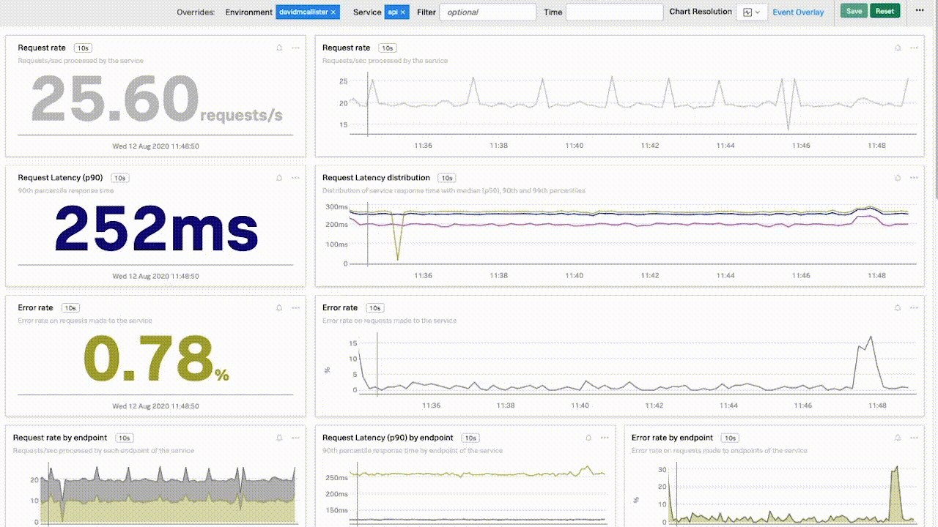
Monitoring is a numbers game
Metrics are numbers that represent selected behavior
Generally
Timestamped
Key-Values
Data, to be useful, must be
Aggregated
Analyzed
Visualized

Slide 5

Some questions to ponder
How do you deal with outliers (spikes) in monitoring?
How do you get a representative value between vastly different quantities (rates, speeds)?
How do you arrive at values to represent rate of change over time?
Do you know what your alert is really showing you?

Slide 6
Mean, Median, Mode
Data:
2, 6, 4, 9, 5, 1, 7, 8, 1, 9, 9, 1, 10, 2, 9, 6, 7, 2, 1, 4, 7, 1, 10, 9, 2, 7, 1, 1, 4, 3, 5, 6, 3, 8, 1, 8, 4, 7, 6, 3, 9, 9, 9, 4, 9, 1, 4, 1, 9, 8, 10, 10, 1, 1, 1, 7, 10, 9, 7, 3, 7, 4
Mean:
A measure of central tendency that represents the average value of a set of data.
Mean = 5.444
Median:
Represents the middle value in a set of ordered data
Median = 6
Mode:
The value that appears most frequently in a set of data.
Mode = 1

Slide 7
Mean, Median, Mode
Data:
2, 6, 4, 9, 5, 1, 7, 8, 1, 9, 9, 1, 10, 2, 9, 6, 7, 2, 1, 4, 7, 1, 10, 9, 2, 7, 1, 1, 4, 3, 5, 6, 3, 8, 1, 8, 4, 7, 6, 3, 9, 9, 9, 4, 9, 1, 4, 1, 9, 8, 10, 10, 1, 1, 1, 7, 10, 9, 7, 3, 7, 4
Mean:
A measure of central tendency that represents the average value of a set of data.
Median:
Represents the middle value in a set of ordered data
Median = 6
Mode:
The value that appears most frequently in a set of data.
Mode = 1
Mean = 5.444 Or is it 4.130 or 2.791?

Slide 8
Means to an End
Arithmetic, Harmonic, Geometric, Trimmed, Weighted, Moving
Each has potential uses and drawbacks
Often already implemented in the monitoring software
Can give very different results
Can make like and unlike comparisons easier
Notes:
Or combo Double Exponential Weighted Moving Average

Slide 9
Arithmetic
2K of 5K
33.33 Requests/sec
Internet
Load Balancer
300 of 1K
5 Requests/sec
Most common
Is the central point in a normal distribution
This is not the 50% mark (mostly)
Useful for comparing current to previous conditions
May be aggregated into groups (time series)
In a time series, we usually calculate constantly to incorporate new data
100 of 600
1.66 Requests/sec
Amean = (33.33 + 5 + 1.66) / 3
Amean = 13.33 Requests per second
Notes:
Is 50% if mean = 0 and std = 1

Slide 10
Geometric
2K of 5K
33.33 Requests/sec
Internet
Load Balancer
300 of 1K
5 Requests/sec
Another central tendency
Often used for things growing exponentially
Multiply all the items together, take the nth root
In DevOps
Average number of deploys per unit of time
Average lead time for changes
MTTR
Throughput
100 of 600
1.66 Requests/sec
Geometric mean = (33.33 * 5 * 1.66) ^ (1/3) = 6.525 requests per second
Notes:
Arithmetic == 13.33

Slide 11
Harmonic
Measure the performance where multiple systems are involved
Weights the lowest figure the highest
Divide n by the sum of the reciprocals
In DevOps
Performance within range
Overall indication of latency or thruput
Use in complex environments
Especially useful for outliers
n / (1/x1 + 1/x2 + ... + 1/xn)
 | First % used | Second % Used
Node 1 | 30% | 30%
Node 2 | 40% | 40%
Node 3 | 20% | 10%
Node 4 | 10% | 80%
Harmonic | 19.19% | 32.82%
Notes:
Server 1 has a CPU utilization of 30%. Server 2 has a CPU utilization of 40%. Server 3 has a CPU utilization of 20%. Server 4 has a CPU utilization of 10%.
This is the equivalent of a single device serving
The presence of a server with a very high CPU utilization of 80% can significantly impact the harmonic mean, making it less useful for identifying underutilized servers or for setting targets for optimal CPU utilization. In cases like this, it may be more appropriate to use other statistical measures, such as the median or trimmed mean, which are less sensitive to outliers.

Slide 12
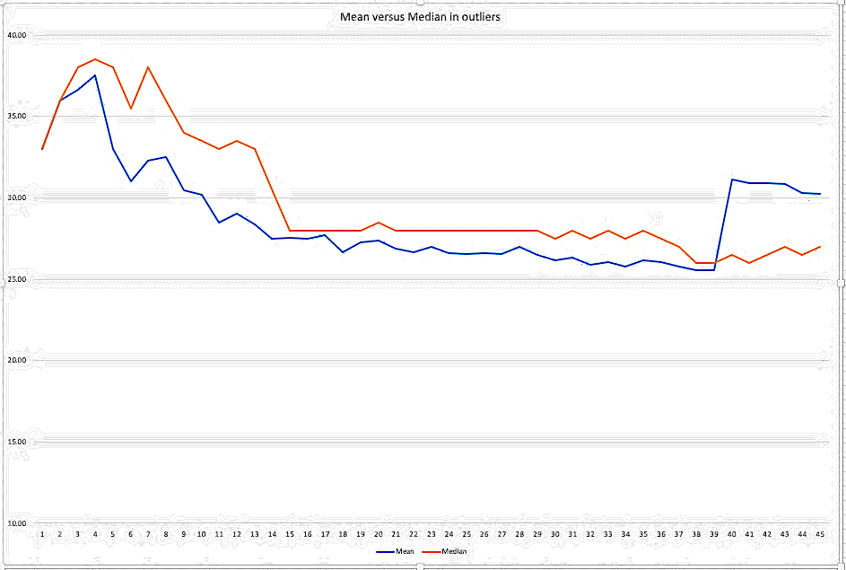
Median
Amazingly underutilized!
Center value of a sorted list
Median is always the 50% point of a normal curve
Mean | 25.25
Median | 26

Slide 13
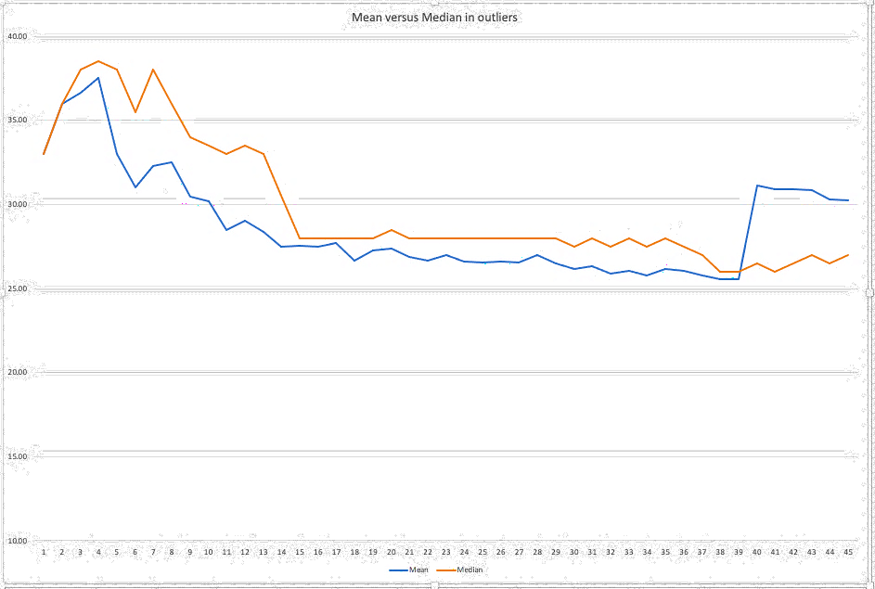
Choosing Between Mean and Median
Mean can be impacted by outliers
Resilience is better in median
In DevOps
Response time monitoring
Anomaly Detection
Capacity Planning
Old |  | New
 | Outlier | 250
25.54 | Mean | 31.15
26 | Median | 26.5
Notes:
Response Time Monitoring: When monitoring the response time of a system, the median is often a better metric to use than the mean. This is because the median represents the value in the middle of a dataset, while the mean is affected by outliers. In situations where there are a few extremely high response times, the mean may be skewed and not represent the typical experience of users. In contrast, the median provides a more accurate representation of the typical response time, making it a better metric to use for alerting.
Anomaly Detection: When detecting anomalies in a system or application, the median can be more effective than the mean. Anomaly detection involves identifying data points that are significantly different from the rest of the data. The median is more robust to outliers, making it more effective in identifying these anomalies. In contrast, the mean can be influenced by outliers and may not accurately represent the typical behavior of the system.
Capacity Planning: When planning for capacity in a system, the median can be a useful metric to use. This is because the median represents the typical behavior of the system, making it more effective in predicting future resource requirements. The mean can be affected by outliers and may not accurately represent the typical resource usage of the system.
Overall, using the median can be more effective in certain monitoring alert use cases than using the mean. By understanding the strengths and weaknesses of each metric, you can choose the best metric for your specific monitoring needs.
This matters when looking for the unexpected
For sudden change, mean is likely a better choice
For historic anomaly, median might be better
Dependent on your timescale

Slide 14
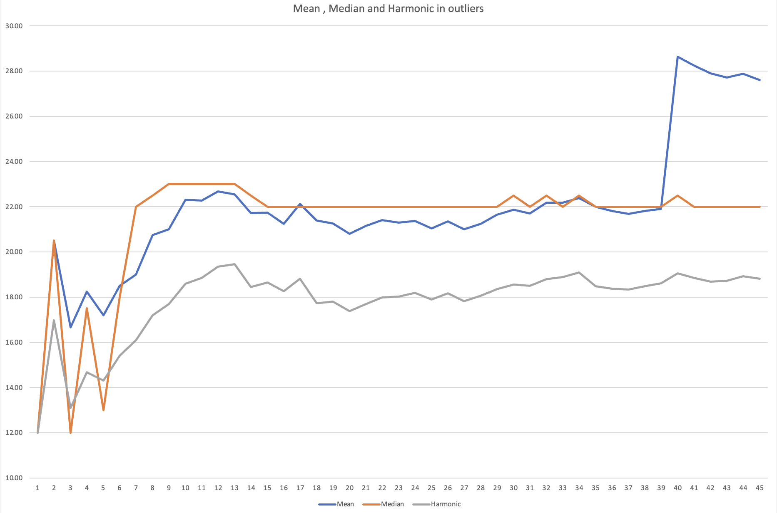
Old |  | New
 | Outlier | 291
21.90 | Mean | 28.63
22 | Median | 22.5
18.61 | Harmonic | 19.06

Slide 15
How about the Mode?
The most commonly recurring value in the set
Often presented as a histograph
Not commonly used in DevOps, mostly inferential
Log Analysis
Security Monitoring
User Behavior Analysis
Notes:
Log Analysis: In DevOps, log analysis is an essential task to identify and troubleshoot issues in systems and applications. The mode can be useful in log analysis to identify the most common error or warning messages that are occurring in a system. By identifying the mode, you can prioritize troubleshooting efforts to address the most frequently occurring issues.
Security Monitoring: In security monitoring, the mode can be used to identify the most common attack vectors that are being used against a system. By analyzing logs or network traffic, you can identify the mode of the types of attacks that are occurring most frequently. This can help you prioritize your security efforts to address the most common attack vectors.
User Behavior Analysis: In DevOps, user behavior analysis is a crucial task to understand how users are interacting with systems and applications. The mode can be useful in identifying the most common user behavior patterns. By analyzing user logs or application usage data, you can identify the mode of the most frequently performed actions. This can help you optimize systems and applications to better support these common user behavior patterns.

Slide 16
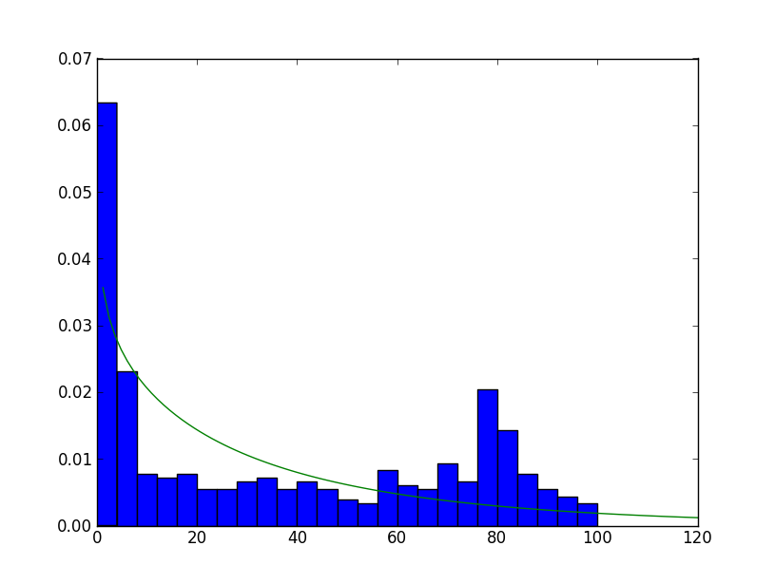
Distributions
Normal
Data equally distributed
Poisson
used to model the occurrence of rare events
Beta
Success/failure of binomial events
Exponential
Time between async events
Weibull
Likelihood of failure
Log-normal
Values based on many small events
Notes:
Normal is also Gaussian
Normal distribution: The normal distribution, also known as the Gaussian distribution, is a bell-shaped distribution that is symmetric around the mean. It is commonly used to model lead times, cycle times, and other metrics that exhibit a roughly symmetrical distribution of values.
Exponential distribution: The exponential distribution is commonly used to model the time between events that occur randomly and independently over time, such as the time between failures of a system or the time between user requests.
Poisson distribution: The Poisson distribution is commonly used to model the occurrence of rare events, such as system failures, errors, or incidents.
Beta distribution: The beta distribution is commonly used to model the probability of success or failure in a binomial process, such as the success rate of a deployment or the defect rate of a system.
Weibull distribution: The Weibull distribution is commonly used to model the time-to-failure of a system or component, and can be used to estimate the reliability and maintainability of a system.
Log-normal distribution: (random variable whose log is a normal distribution. The log-normal distribution is commonly used to model the distribution of values that are the product of many small independent factors, such as the response time of a web application or the size of files transferred in a network.

Slide 17
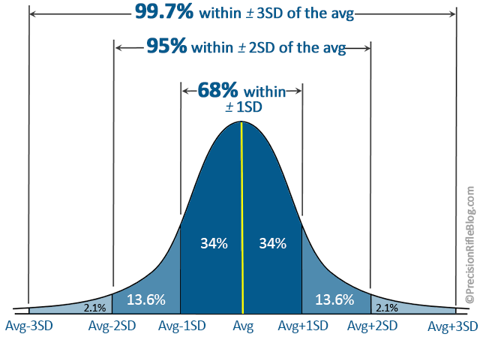
Slight sidetrack: Standard deviation
Measures the variability of your data
Identifies trends and outliers
NOT percentage based
Except with coefficient of variability
CV=Mean / std dev X 100
Useful for measurement ignoring range
SRE cases
Lead times
Recovery times
Anomalies (alerts)
SLO / SLI
This Photo by Unknown Author is licensed under CC BY-NC-ND

Slide 18
Deeper dive: Weibull
Usually used for time-to-failure
Defined by a Shape and a Scale parameter
This can be challenging
Don’t ask the math
R does it for you!
library(fitdistrplus)
data <- c(500, 1000, 1500, 2000, 2500)
fit.weib <- fitdist(data, "weibull")
summary(fit.weib)
Fitting of the distribution ' weibull ' by maximum likelihood
Parameters : estimate Std. Error
shape 1.0624082 0.3820112
scale 2158.2561922 943.0326941
Component | Time-to-Failure
Spinning Rust | 500 hours
Memory | 1000 hours
Power Supply | 1500 hours
CPU | 2000 hours
SSD | 2500 hours
p.failure <- pweibull(3000, shape = fit.weib$estimate[1], scale = fit.weib$estimate[2])
1 - p.failure
[1] 0.2905977

Slide 19
Deeper dive: Exponential
User request arrival time | Count
5 seconds | 120
10 seconds | 60
15 seconds | 30
20 seconds | 10
Models the “rate” (time between events that are unrelated)
Use cases
Network performance
User Requests
Messaging service
System failures
Don’t ask the math
R does it for you
library(MASS)
data <- c(rep(5, 120), rep(10, 60), rep(15, 30), rep(20, 10))
fit.exp <- fitdistr(data, "exponential")
summary(fit.exp)
estimate
rate 0.04232899
p.request <- pexp(10, rate = fit.exp$estimate)
p.request
[1] 0.3943056
Notes:
Tracing!
This indicates that there is a 39.43% probability of a request arriving within the next 10 seconds, based on the exponential distribution fitted to the inter-arrival time data.

Slide 20
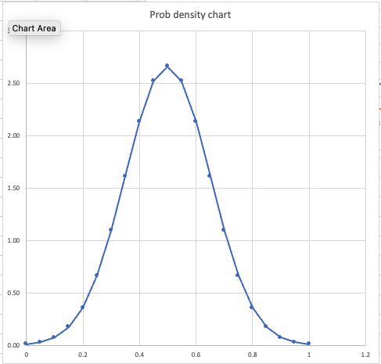
Deeper Dive: Probability Distribution Function
Describes the probability
Of a random variable
Shows likelihood of observation
Is non-negative
Make informed decisions
Math: f(x) = (1 / (σ * sqrt(2π))) * exp(-((x - μ)² / (2σ²)))
f(x) is the PDF at a given value x,
CPU Utilization
Mean = 50% utilization
STDev= 15%
Prob of CPU between
60% and 80% = 5.86%

Slide 21
Slight sidetrack: Descriptive versus Inferential stats
Descriptive uses the whole data set to draw statistical conclusions
Used for visualization
Can define and extract trends
Inferential uses a sampled set to draw conclusions
Used for predictions or hypotenuse testing
Can also visualize
But this leads us to sampling

Slide 22
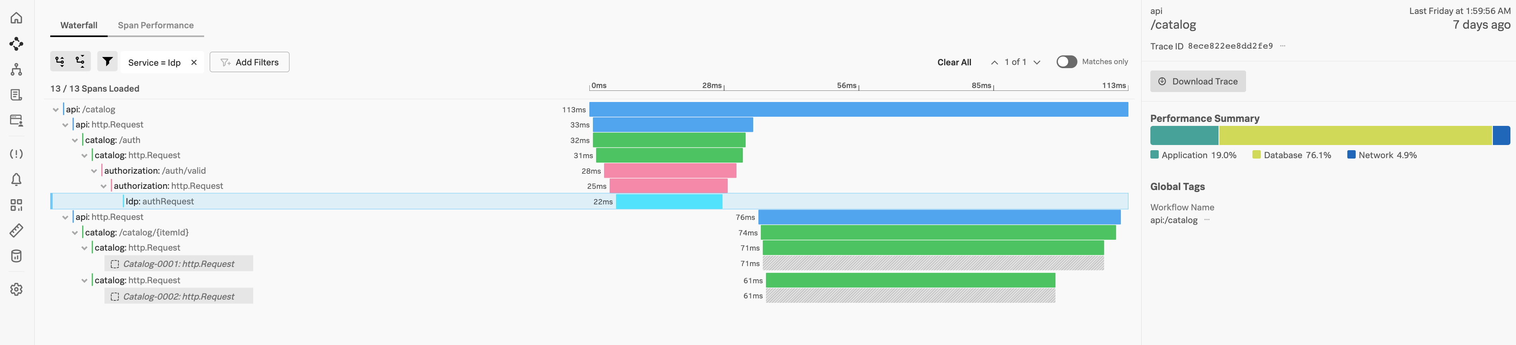
Dealing with the data
Monitoring is now a data problem
Observability signals: Metrics, Traces, Logs
Analysis is often
Aggregated or Analyzed in segments: Time-defined
Sampled and inferential
Random sampling
Stratified sampling
Cluster sampling
Systematic sampling
Purposive sampling
Notes:
Simple random sampling: This is the most basic sampling technique, where each member of the population has an equal chance of being selected for the sample. This can be done using a random number generator or a table of random numbers.
Stratified sampling: This technique involves dividing the population into subgroups or strata based on a relevant variable, such as location, department, or system component. A sample is then selected from each stratum based on a proportionate or disproportionate allocation, depending on the goals of the study.
Cluster sampling: This technique involves dividing the population into clusters or groups based on a relevant variable, such as data center, application, or user group. A sample of clusters is then selected, and data is collected from all members within each selected cluster.
Systematic sampling: This technique involves selecting every nth member of the population, where n is a fixed interval that is determined based on the size of the population and the desired sample size.
Purposive sampling: This technique involves selecting members of the population based on a specific criterion or characteristic that is of interest to the study, such as selecting only high-priority incidents or vulnerabilities for analysis.

Slide 23
Lets consider tracing and sampling
START TRACE
END TRACE
Head-Based Sampling
Tail-Based Sampling
Purely random
Retention rate = Coverage
Not really random
Fault rate = Coverage

Slide 24
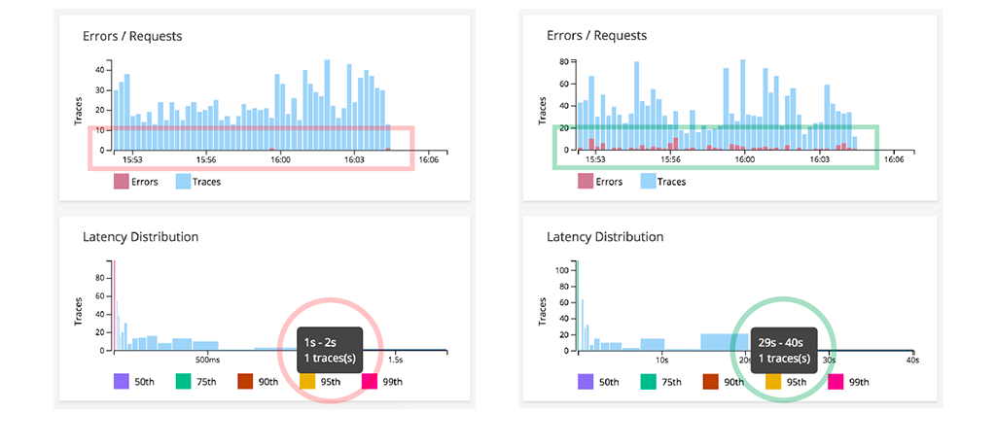
Sampling
No Sampling
Notes:
Here’s an example Take the same data sets:
In #1 data is Is sampled
In #2 it is not
sampling is giving me a selection bias and it doesn’t see things that are out of range, so it thinks my duration is 2 seconds when in reality my duration is 29 to 40 seconds. In other words it’s causing blind spots!!
And in my world, 29 seconds is known as a lost sale, I have abandoned many frivolous online purchases for even less latency than that.

Slide 25

Sampling
Changes behavior from Descriptive to Inferential
Can hide outlier behavior
Metrics are not usually sampled
May make forensics tougher
Lack of direct correlation
A necessary evil

Slide 26
Summary
Statistics are how we tend to analyze our metrics
Statistics are aggregation and reduction to reveal central tendencies
They do not show individual behavior
Most choices make use of very few basics
But other choices may show amazing inferential results
And finally

Slide 27
Summary
Statistics are how we tend to analyze our metrics
Statistics are aggregation and reduction to reveal central tendencies
They do not show individual behavior
Most choices make use of very few basics
But other choices may show amazing inferential results
And finally
The most effective debugging tool is still careful thought, coupled with judiciously placed print statements.
-Brian Kernighan Unix for Beginners 1979

Slide 28
D(9) = 286 386 577 668 298 411 128 469 151 667 598 498 812 366

Slide 29


Thanks!
Slides on GitHub: dwmcallister
Linkedin: in/davemc
NGINX Community Slack

